Slide 1
Bioinformatics
Lecture 2
“Pairwise and Multiple Sequence Alignment”
Course code : MDS 657 28th July 2025
Roji Raut

Slide 2
Unit 2 : Pairwise and Multiple Sequence Alignment (10hrs)
Pairwise Sequence alignment, Substitution matrix, PAM and BLOSUM, Dot matrix, Dynamic Programming, Local Alignment and Global Alignment, Heuristic Method: FASTA, BLAST, comparisions, Multiple Sequence alignment, Guide tree, Types of MSA, Applications

Slide 3
Sequence Alignment
Sequence comparison lies at the heart of bioinformatics analysis.
Given two or more sequences, we may want to:
measure their similarity;
determine the residue–residue correspondences;
observe patterns of conservation and variability;
infer evolutionary relationships.
If we can do these, we will be in a good position to go fishing in data banks for related sequences.
A major application is to the annotation of genomes, involving assignment of structure and function to as many genes as possible.

Slide 4
Sequence Alignment
Before comparing the nucleotides or amino acids that appear at corresponding positions in two or more sequences, we must first assign those correspondences.
Sequence alignment is the identification of residue–residue correspondences.
It is the basic tool of bioinformatics.
It is an important first step toward structural and functional analysis of newly determined sequences.

Slide 5
Sequence Alignment
As new biological sequences are being generated at exponential rates, sequence comparison is becoming increasingly important to draw functional and evolutionary inference of a new protein with proteins already existing in the database.
The most fundamental process in this type of comparison is sequence alignment.
This is the process by which sequences are compared by searching for common character patterns and establishing residue–residue correspondence among related sequences.

Slide 6
Sequence Alignment
DNA and proteins are products of evolution.
The building blocks of these biological macromolecules, nucleotide bases, and amino acids form linear sequences that determine the primary structure of the molecules.
These molecules can be considered molecular fossils that encode the history of millions of years of evolution.
During this time period, the molecular sequences undergo random changes, some of which are selected during the process of evolution.

Slide 7
Sequence Alignment
As the selected sequences gradually accumulate mutations and diverge over time, traces of evolution may still remain in certain portions of the sequences to allow identification of the common ancestry.
Some of the residues that perform key functional and structural roles tend to be preserved by natural selection; other residues that may be less crucial for structure and function tend to mutate more frequently.
For example, active site residues of an enzyme family tend to be conserved because they are responsible for catalytic functions.

Slide 8
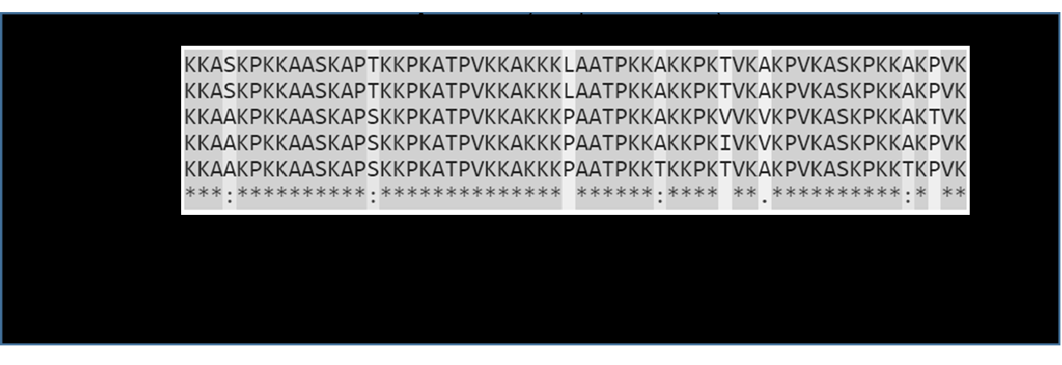
Sequence Alignment
The degree of sequence conservation in the alignment reveals evolutionary relatedness of different sequences, whereas the variation between sequences reflects the changes that have occurred during evolution in the form of substitutions, insertions, and deletions.
Identifying the evolutionary relationships between sequences helps to characterize the function of unknown sequences.
When a sequence alignment reveals significant similarity among a group of sequences, they can be considered as belonging to the same family

Slide 9
Sequence Alignment
If one member within the family has a known structure and function, then that information can be transferred to those that have not yet been experimentally characterized.
Therefore, sequence alignment can be used as basis for prediction of structure and function of uncharacterized sequences.
If the two sequences share significant similarity, it is extremely unlikely that the extensive similarity between the two sequences has been acquired randomly, meaning that the two sequences must have derived from a common evolutionary origin.

Slide 10
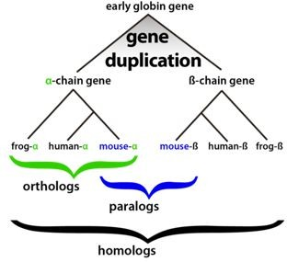
Sequence Alignment
Homology vs Similarity
Homology: when two sequences are descended from a common evolutionary origin.
Sequence similarity, which is the percentage of aligned residues that are similar in physiochemical properties such as size, charge, and hydrophobicity.
Sequence homology is an inference or a conclusion about a common ancestral relationship drawn from sequence similarity comparison when the two sequences share a high enough degree of similarity.
Similarity is a direct result of observation from the sequence alignment.

Slide 11
Sequence Alignment
Homology vs Similarity
Sequence similarity can be quantified using percentages; homology is a qualitative statement. For example, one may say that two sequences share 40% similarity. It is incorrect to say that the two sequences share 40% homology.
Generally, if the sequence similarity level is high enough, a common evolutionary relationship can be inferred.
In dealing with real research problems, the issue of at what similarity level can one infer homologous relationships is not always clear.
The answer depends on the type of sequences being examined and sequence lengths.

Slide 12
Sequence Alignment
Homology vs Similarity
Nucleotide sequences consist of only four characters, and therefore, unrelated sequences have at least a 25% chance of being identical.
For protein sequences, there are twenty possible amino acid residues, and so two unrelated sequences can match up 5% of the residues by random chance.
Sequence length is also a crucial factor.
The shorter the sequence, the higher the chance that some alignment is attributable to random chance. The longer the sequence, the less likely the matching at the same level of similarity is attributable to random chance.
This suggests that shorter sequences require higher cutoffs for inferring homologous relationships than longer sequences.

Slide 13
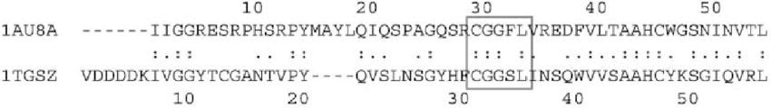
Sequence Alignment
Similarity vs Identity
Sequence similarity and sequence identity are synonymous for nucleotide sequences.
In a protein sequence alignment, sequence identity refers to the percentage of matches of the same amino acid residues between two aligned sequences.
Similarity refers to the percentage of aligned residues that have similar physicochemical characteristics and can be more readily substituted for each other.

Slide 14
Sequence Alignment
Depending on the number of sequences aligned, two types:
pairwise sequence alignment : Two sequences aligned
multiple sequence alignment : A mutual alignment of more than two sequences
The overall goal of pairwise sequence alignment is to find the best pairing of two sequences, such that there is maximum correspondence among residues.
To achieve this goal, one sequence needs to be shifted relative to the other to find the position where maximum matches are found.
There are two different alignment strategies that are often used: global alignment and local alignment.

Slide 15
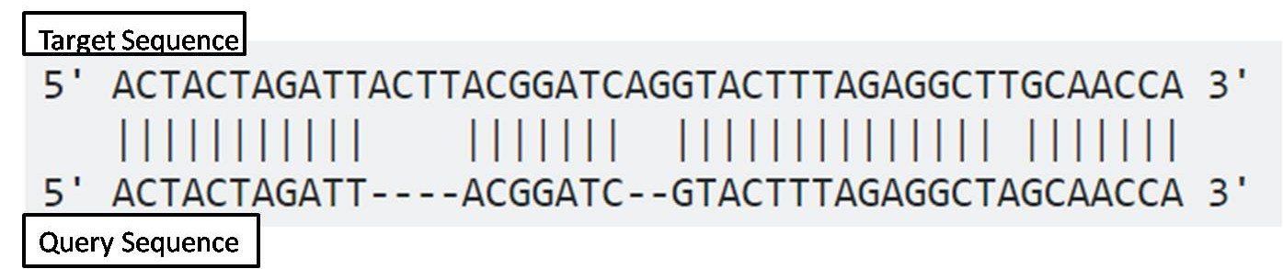
Sequence Alignment
Global Alignment:
In global alignment, two sequences to be aligned are assumed to be generally similar over their entire length.
Alignment is carried out from beginning to end of both sequences to find the best possible alignment across the entire length between the two sequences.
This method is more applicable for aligning two closely related sequences of roughly the same length.
For divergent sequences and sequences of variable lengths, this method may not be able to generate optimal results because it fails to recognize highly similar local regions between the two sequences.

Slide 16
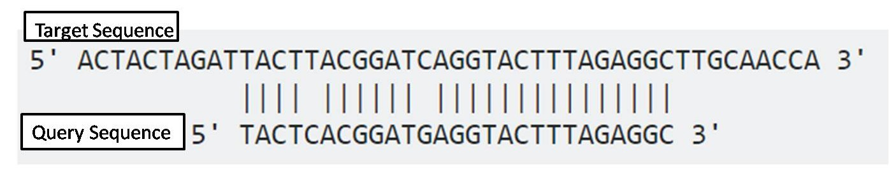
Sequence Alignment
Local alignment:
Local alignment does not assume that the two sequences in question have similarity over the entire length.
It only finds local regions with the highest level of similarity between the two sequences and aligns these regions without regard for the alignment of the rest of the sequence regions.
This approach can be used for aligning more divergent sequences with the goal of searching for conserved patterns in DNA or protein sequences.
The two sequences to be aligned can be of different lengths.
This approach is more appropriate for aligning divergent biological sequences containing only modules that are similar, which are referred to as domains or motifs.

Slide 17
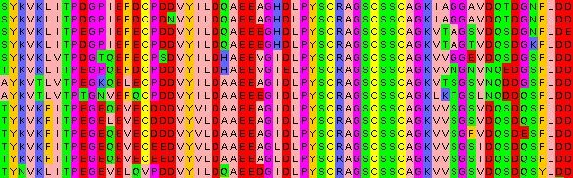
Sequence Alignment
Multiple sequence alignments are much more informative than pairwise sequence alignments in terms of revealing patterns of conservation.
This is usually used to find large families of similar sequences by identifying homologues in different species.

Slide 18


Sequence Alignment
Any assignment of correspondences that preserves the order of the residues within the sequences is an alignment
During an alignment gaps may be introduced but the order of residues is never changed.
Given two text strings, a reasonable alignment would be:

Slide 19
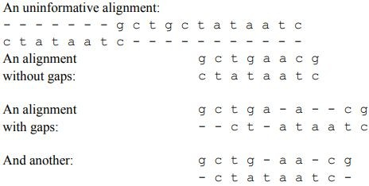
Sequence Alignment
But we can never be sure which alignment is the best.
Given two sequence :
GCTGAACG – length m
CTATAATC – length n
# of alignments = m*n

Slide 20
Sequence Alignment
To decide which of these alignments is the correct one, we need a way to examine all possible alignments systematically.
Then we need to compute a score reflecting the quality of each possible alignment.
Then we can identify the alignment with the optimal score.
In many cases, the optimal alignment is not unique: several different alignments may give the same best score.
Moreover, even minor variations in the scoring scheme may change the ranking of alignments, causing a different one to emerge as the best.

Slide 21
Sequence Alignment
Different types of algorithms can be based on one of the three methods for pairwise alignment:
Dot matrix method (dot plot method)
Dynamic programming method,
Word method.

Slide 22
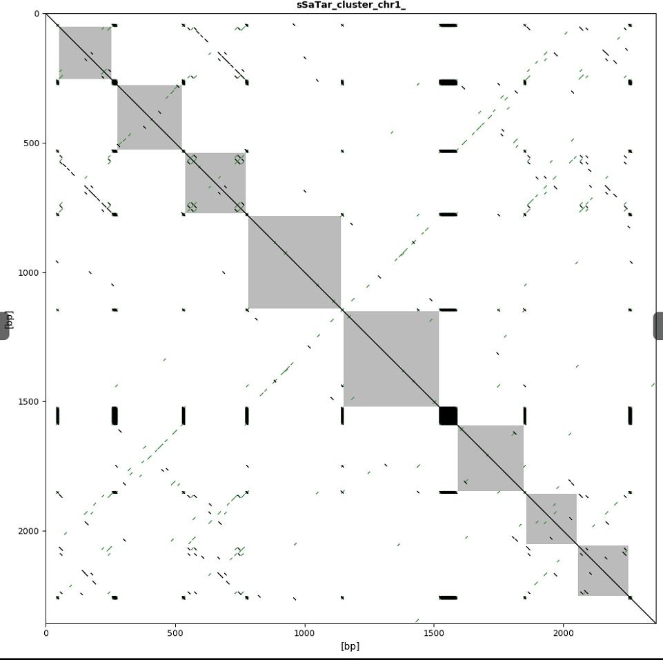
Sequence Alignment
Dot Matrix Method:
It is a graphical way of comparing two sequences in a two dimensional matrix.
Two sequences to be compared are written in the horizontal and vertical axes of the matrix.
This produces a dotplot : The dotplot is a simple picture that gives an overview of the similarities between two sequences.

Slide 23
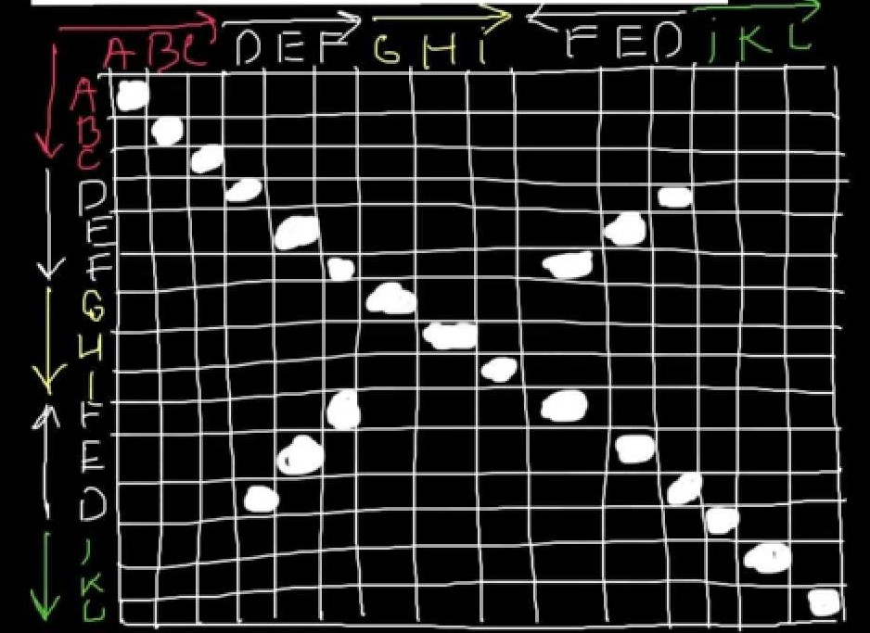
Sequence Alignment
Dot Matrix Method:
The dotplot is a table or matrix.
The rows correspond to the residues of one sequence and the columns to the residues of the other sequence.
The comparison is done by scanning each residue of one sequence for similarity with all residues in the other sequence.
If a residue match is found, a dot is placed within the graph. Otherwise, the matrix positions are left blank.

Slide 24
Sequence Alignment
Dot Matrix Method:
When the two sequences have substantial regions of similarity, many dots line up to form contiguous diagonal lines, which reveal the sequence alignment.
If there are interruptions in the middle of a diagonal line, they indicate insertions or deletions.
Parallel diagonal lines within the matrix represent repetitive regions of the sequences.

Slide 25
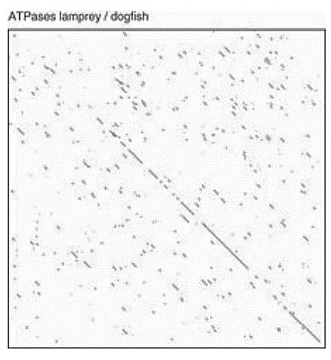
Sequence Alignment
The dotplot
In its simplest form, the positions in the dotplot are left blank if the residues are different, and filled if they match.
Stretches of similar residues show up as diagonals in the upper left–lower right direction
The dotplot gives a quick pictorial statement of the relationship between two sequences.
Obvious features of similarity stand out.

Slide 26
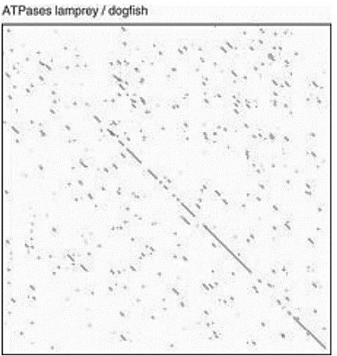
Sequence Alignment
The dotplot
For example, a dotplot relating the mitochondrial ATPase-6 genes from a lamprey (Petromyzon marinus) and dogfish (Scyliorhinus canicula) shows that the similarity of the sequences is weakest near the beginning.

Slide 27
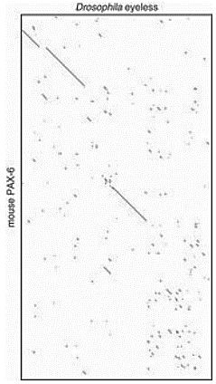
Sequence Alignment
The dotplot
Often regions of similarity may be displaced, to appear on parallel but not collinear diagonals.
This indicates that insertions or deletions have occurred in the segments between the similar regions.
A dotplot relating the PAX-6 protein of mouse and the eyeless protein of D. melanogaster shows three extended regions of similarity with different lengths of sequence between them, two near the beginning of the sequences and one near the middle.
Between the second and third of them, there is a longer intervening region in the mouse than in the Drosophila sequence.

Slide 28
Sequence Alignment
The dotplot
A sequence can be aligned with itself to identify internal repeat elements.
In the self comparison, there is a main diagonal for perfect matching of each residue.
If repeats are present, short parallel lines are observed above and below the main diagonal.
Self complementarity of DNA sequences (also called inverted repeats) can also be identified using a dot plot.
In this case, a DNA sequence is compared with its reverse complemented sequence.
Parallel diagonals represent the inverted repeats.

Slide 29
Sequence Alignment
The dotplot
Plot becomes too noisy when we compare large and similar sequences.
In most dot plots, dots are plotted all over the graph, obscuring identification of the true alignment.
For DNA sequences, the problem is particularly acute because there are only four possible characters in DNA.
To reduce noise, instead of using a single residue to scan for similarity, a filtering technique has to be applied, which uses a “window” of fixed length covering a stretch of residue pairs.
When applying filtering, windows slide across the two sequences to compare all possible stretches.
Dots are only placed when a stretch of residues equal to the stringency value.

Slide 30
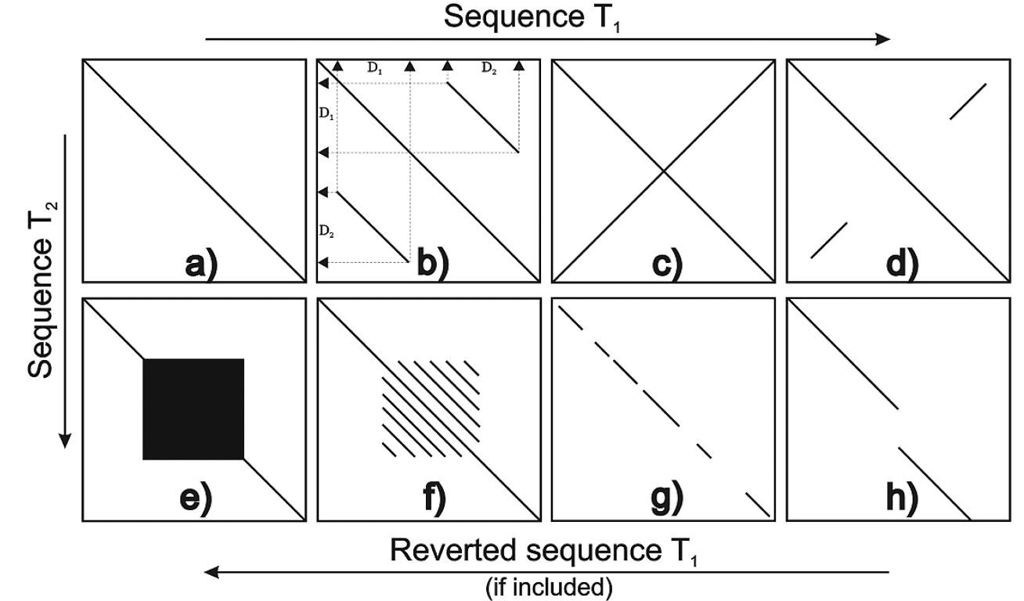
Sequence Alignment

Slide 31
Sequence Alignment
The dotplot : Limitations
The dot matrix method gives a direct visual statement of the relationship between two sequences and helps easy identification of the regions of greatest similarities.
One particular advantage of this method is in identification of sequence repeat regions based on the presence of parallel diagonals of the same size vertically or horizontally in the matrix.
It is often up to the user to construct a full alignment with insertions and deletions by linking nearby diagonals.
Another limitation of this visual analysis method is that it lacks statistical rigor in assessing the quality of the alignment.
The method is also restricted to pairwise alignment.

Slide 32
Sequence Alignment
The dotplot : Limitations
A disadvantage of the dotplot is that its ‘reach’ into the realm of distantly related sequences is poor.
In analysing sequences, one should always look at a dotplot to be sure of not missing anything obvious, but be prepared to apply more sensitive tools.
The dotplot captures in a single picture not only the overall similarity of two sequences, but also the complete set and relative quality of different possible alignments.
Any path through the dotplot from upper left to lower right corresponds to a possible alignment.
If two sequences are closely related, the alignment can be read directly off the dotplot.

Slide 33
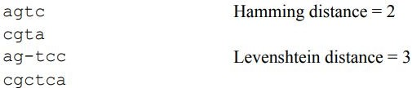
Sequence Alignment
To go beyond ‘alignment by eyeball’ via dotplots, we must define quantitative measures of sequence similarity and difference.
Given two character strings, two measures of the distance between them are:
the Hamming distance, defined between two strings of equal length, is the number of positions with mismatching characters;
the Levenshtein, or edit, distance, defined between two strings of not necessarily equal length, is the minimal number of ‘edit operations’ required to change one string into the other. An edit operation is a deletion, insertion, or alteration of a single character in either sequence.

Slide 34
Sequence Alignment
Measures of sequence similarity
For applications to molecular biology, recognize that certain changes are more likely to occur than others.
For example, amino acid substitutions tend to be conservative: the replacement of one amino acid by another with similar size or physicochemical properties is more likely to have occurred than its replacement by another amino acid with greater differences.
Or, the deletion of a succession of contiguous bases or amino acids is a more probable event than the independent deletion of the same number of bases or amino acids at noncontiguous positions in the sequences.

Slide 35
Sequence Alignment
Measures of sequence similarity
Therefore, we may wish to assign variable weights to different edit operations.
A computer program can then determine not just minimal edit distances but optimal alignments.
It can score each path by adding up the scores of the individual steps.
For substitutions, it adds the score of the mutation, depending on the pair of residues involved.
For horizontal and vertical moves, it adds a suitable gap penalty.

Slide 36
Sequence Alignment
Scoring system
A scoring system must account for residue substitutions, and insertions or deletions.
Deletions, or gaps in a sequence, will have scores that depend on their lengths.
Hamming and Levenshtein distances measure the dissimilarity of two sequences: similar sequences give small distances and dissimilar sequences give large distances.
It is common in molecular biology to define scores as measures of sequence similarity.
Then similar sequences give high scores and dissimilar sequences give low scores.

Slide 37
Sequence Alignment
Scoring system
The scoring systems is called a substitution matrix and is derived from statistical analysis of residue substitution data from sets of reliable alignments of highly related sequences.
A substitution matrix is a collection of scores for aligning nucleotides or amino acids with one another. These scores generally represent the relative ease with which one nucleotide or amino acid may mutate into or substitute for another, and they are used to measure similarity in sequence alignments.
Substitution matrices are used in conjunction with gap costs to construct local or global alignments.

Slide 38
Sequence Alignment
Scoring system
Substitution matrices for nucleotide sequences are relatively simple. A positive value or high score is given for a match and a negative value or low score for a mismatch.
This assignment is based on the assumption that the frequencies of mutation are equal for all bases.
However, this assumption may not be realistic; observations show that transitions occur more frequently than transversions.

Slide 39
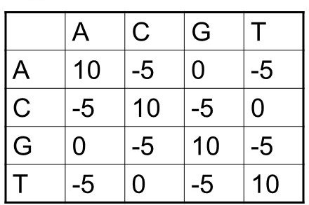
Sequence Alignment
Scoring system
For nucleotides, higher scores for matches and lower or negatives scores are given for mismatches
There is no problem of scoring during a match
But during a mismatch the scores given may be equal in all cases if all 4 nucleotides have same probability of being mutated
But this is not true– Purine-Purine substitution and Pyrimidine-Pyrimidine substitution is more likely
Substitution of Adenine & Guanine and Cytosine & Thymine is more likely and results in only slightly lower score than a identical match.

Slide 40
Sequence Alignment
Scoring system
Algorithms for optimal alignment can seek either to minimize a dissimilarity measure or to maximize a scoring function.
For nucleic acid sequences, it is common to use a simple scheme for substitutions: +1 for a match, −1 for a mismatch, or a more complicated scheme based on a higher frequency of transition mutations than transversion mutations.
For proteins, a variety of scoring schemes have been proposed.
We might group the amino acids into classes of similar physicochemical type, and score +1 for a match within residue class and –1 for residues in different classes.

Slide 41
Sequence Alignment
Scoring system
Scoring matrices for amino acids are more complicated because scoring has to reflect the physicochemical properties of amino acid residues, as well as the likelihood of certain residues being substituted among true homologous sequences.
Certain amino acids with similar physicochemical properties can be more easily substituted than those without similar characteristics. Substitutions among similar residues are likely to preserve the essential functional and structural features.
Amino acid substitution matrices, which are 20 × 20 matrices, have been devised to reflect the likelihood of residue substitutions.

Slide 42
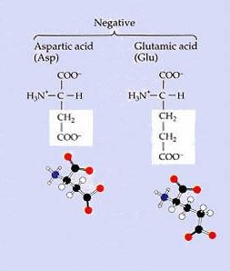
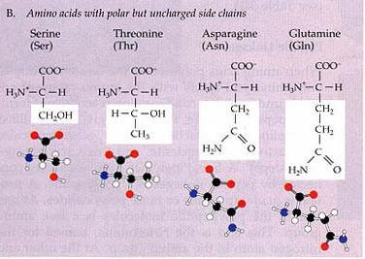
Sequence Alignment
Scoring system

Slide 43
Sequence Alignment
Scoring system
There are 2 approaches
Based on genetic code or physicochemical properties of amino acids : We might try to devise a more precise substitution score from a combination of properties of the amino acids.
Based on the actual amino acids substitutions among related proteins called empirical matrix : We might try to let the proteins teach us an appropriate scoring scheme.
First approach has been shown to be less accurate than the second approach.
M.O. Dayhoff collected statistics on substitution frequencies in the protein sequences then known to create the first substitution matrix.
Her results were used for many years to score alignments.
They have been superseded by newer matrices based on the very much larger set of sequences that has subsequently become available.

Slide 44
Sequence Alignment
Substitution Matrix
By analyzing the probabilities of amino acid substitutions in alignments, a scoring system can be developed by giving a high score for a more likely substitution and a low score for a rare substitution.
A positive score means that the frequency of amino acid substitutions found in a data set of homologous sequences is greater than would have occurred by random chance.
They represent substitutions of very similar residues or identical residues.

Slide 45
Sequence Alignment
Substitution Matrix
A zero score means that the frequency of amino acid substitutions found in the homologous sequence data set is equal to that expected by chance.
In this case, the relationship between the amino acids is weakly similar at best in terms of physicochemical properties.
A negative score means that the frequency of amino acid substitutions found in the homologous sequence data set is less than would have occurred by random chance.
This normally occurs with substitutions between dissimilar residues.

Slide 46

Sequence Alignment
Substitution Matrix
Given a pair of aligned sequences, we want to assign a score to the alignment that gives a measure of the relative likelihood that the sequences are related as opposed to being unrelated.
We do this by having models that assign a probability to the alignment in each of the two cases; we then consider the ratio of the two probabilities.
The unrelated or random model R is simplest.
It assumes that letter a occurs independently with some frequency q , and
hence the probability of the two sequences is just the product of the probabilities of each amino acid:
a

Slide 47

Sequence Alignment
Substitution Matrix
In the alternative match model M, aligned pairs of residues occur with a joint probability p_{ab}.
This value p can be thought of as the probability that the residues a and b
ab
have each independently been derived from some unknown original residue c
in their common ancestor.
This gives a probability for the whole alignment of

Slide 48
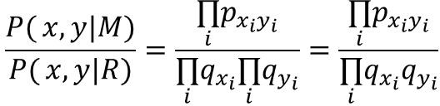
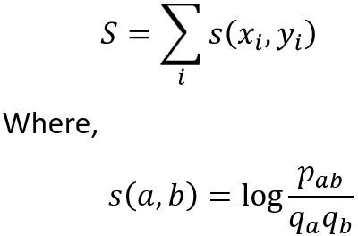
Sequence Alignment
Substitution Matrix
The ratio of these two likelihoods is known as the
odds ratio:
In order to arrive at an additive scoring system, we take the logarithm of this ratio, known as the
log-odds ratio:

Slide 49
Sequence Alignment
Substitution Matrix
The s(a,b) scores can be arranged in a matrix. For proteins, for instance, they form a 20 × 20 matrix, with s(a_{i},aj) in position i, j in the matrix, where a_{i},a_{j} are the ith and jth amino acids (in some numbering).
This is known as a score matrix or a substitution matrix.
These are based on surveys of actual amino acid substitutions among related proteins.
Most widely used: PAM and BLOSUM

Slide 50
Substitution Matrix
As sequences diverge, mutations accumulate.
To measure the relative probability of any particular substitution, for instance serine→threonine, we can count the number of serine→threonine changes in pairs of aligned homologous sequences.
We could use the relative frequencies of such changes to form a scoring matrix for substitutions.
A common change should score higher than a rare one.
But, what if there have been multiple substitutions at certain sites? This will bias the statistics.
We can avoid this problem by restricting our samples to sequences that are sufficiently similar that we can assume that no position has changed more than once.

Slide 51
Substitution Matrix
PAM matrix
The first systematic method to derive amino acid substitution matrices was done by Margaret Dayhoff et al. (1978) Atlas of Protein Structure.
These widely used substitution matrices are frequently called Dayhoff, MDM (Mutation Data Matrix), or PAM (Point Accepted Mutation) matrices.
A point accepted mutation — also known as a PAM — is the replacement of a single amino acid in the primary structure of a protein with another single amino acid, which is accepted by the processes of natural selection.

Slide 52
Substitution Matrix
PAM matrix
A PAM matrix is a matrix where each column and row represents one of the twenty standard amino acids.
Each entry in a PAM matrix indicates the likelihood of the amino acid of that row being replaced with the amino acid of that column through a series of one or more point accepted mutations during a specified evolutionary interval, rather than these two amino acids being aligned due to chance.
Different PAM matrices correspond to different lengths of time in the evolution of the protein sequence.

Slide 53
Substitution Matrix
PAM matrix
A measure of sequence divergence is the PAM, where 1 PAM = 1 per cent accepted mutation.
Thus, two sequences 1 PAM apart have 99% identical residues.
For pairs of sequences within the 1 PAM level of divergence, it is likely that there has been no more than one change at any position.
Collecting statistics from pairs of sequences as closely related as this, and correcting for different amino acid abundances, produces the 1 PAM substitution matrix.

Slide 54
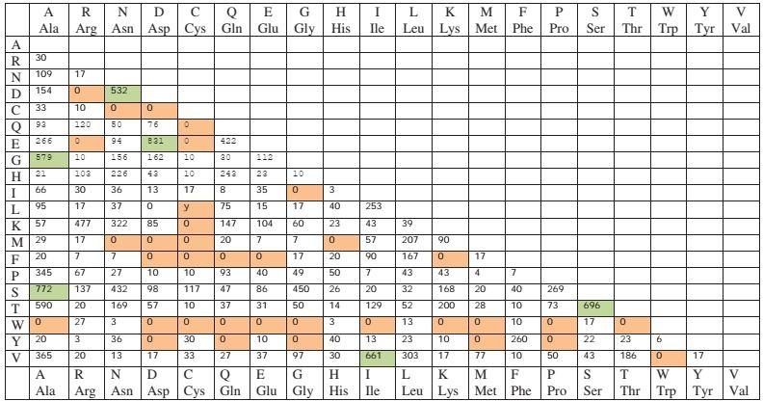
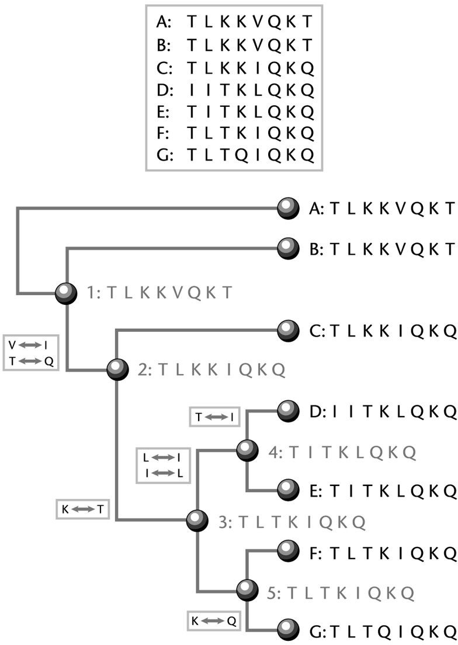
Substitution Matrix
PAM matrix
Step 1. Dayhoff used 71 protein families, made hypothetical phylogenetic trees and recorded the number of observed substitutions (along each branch of the tree) in a 20x20 target matrix.

Slide 55



Substitution Matrix
PAM matrix
Step 2. The target matrix was then converted to frequencies by dividing each cell (a,b) over the sum of all other substitutions of a.
Step 3. The target matrix was normalized so that the expected number of substitutions covered 1% of the protein (PAM-1).
Step 4. Determine the final substitution matrix.

Slide 56

Substitution Matrix
PAM matrix
One PAM represents a 1% change in all residues or one Point Accepted Mutation per 100 residues.
The matrices are scaled from there, so the PAM100 matrix represents 100% change, the PAM250 matrix represents 250% change, and so forth.
The PAM250 level, corresponding to ≈20% overall sequence identity, is the lowest sequence similarity for which we can hope to produce a correct alignment by simple pairwise sequence comparison alone.
It is therefore the appropriate level to choose for practical work.
Several authors have derived substitution matrices appropriate in different ranges of overall sequence similarity.

Slide 57
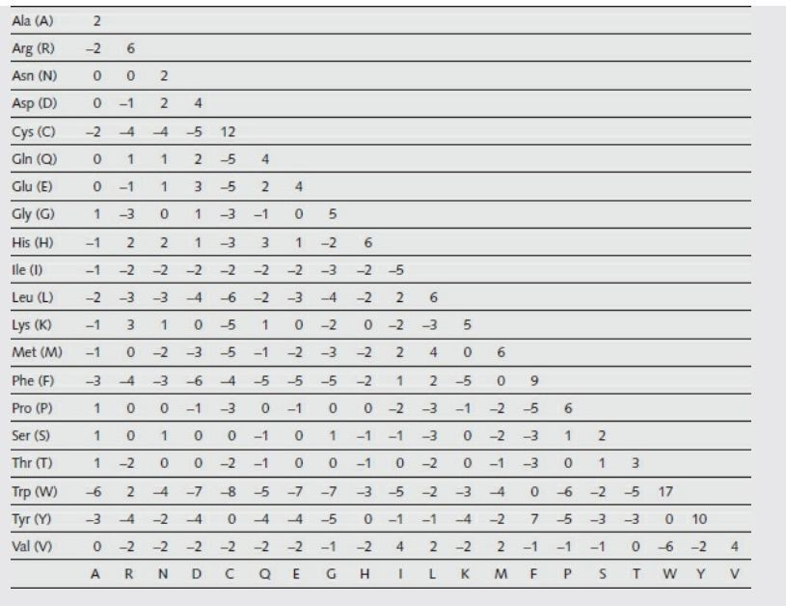
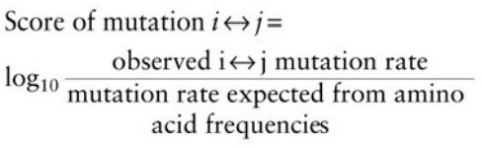
Substitution Matrix
PAM matrix
This is the PAM 250 matrix
It expresses scores as log-odds values:
The numbers are multiplied by 10, simply to avoid decimal points.

Slide 58
Substitution Matrix
PAM matrix
The matrix entries reflect the probabilities of mutational events.
A value of +2—for instance, C↔S—implies that in related sequences the mutation would be expected to occur 1.6 times more frequently than random.
The calculation is as follows:
the matrix entry 2 corresponds to the actual value 0.2 because of the scaling.
The value 0.2 is log10 of the relative expectation value of the mutation. Therefore, this expectation value is 10^{0.2} = 1.6.

Slide 59
Substitution Matrix
PAM matrix
The scores derived through the PAM model are an accurate description of the information content (or the relative entropy) of an alignment.
PAM1 corresponds to about 1 million years of evolution.
PAM120 has the largest information content of the PAM matrix series: “best” for general alignment.
PAM250 is the traditionally most popular matrix: “best” for detecting distant sequence similarity.

Slide 60
Substitution Matrix
The BLOSUM matrices
S. Henikoff and J.G. Henikoff developed the family of BLOSUM matrices for scoring substitutions in amino acid sequence comparisons.
Their goal was to replace the Dayhoff matrix with one that would perform best in identifying distant relationships, making use of the much larger amount of sequence data that had become available since Dayhoff’s work.
The BLOSUM matrices are based on the BLOCKS database of aligned protein sequences; hence the name BLOcks SUbstitution Matrix.
It is based on local multiple alignments of more distantly related sequences.

Slide 61
Substitution Matrix
The BLOSUM matrices
In each alignment the sequences similar at some threshold value of percent identity were clustered into groups and averaged.
Substitution frequencies for all pairs of amino acids were calculated between the groups, this was used to create the log odds BLOSUM ( Block Substitution Matrix ).
Thus, BLOSUM62 means that the sequences clustered in this block are at most 62% identical.

Slide 62
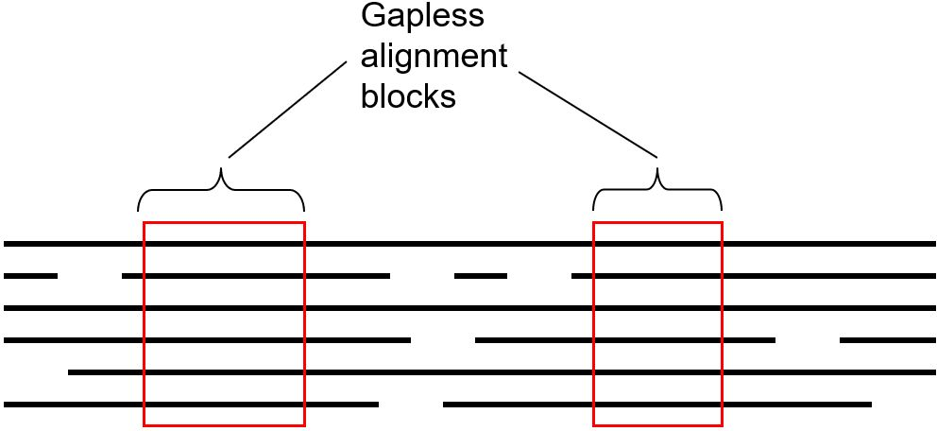
Substitution Matrix
The BLOSUM matrices
Henikoff and Henikoff developed a database of “blocks” based on sequences with shared motifs (>2,000 blocks of aligned sequence segments from >500 groups of related proteins)
WHY BLOCKS?
Need to have a multiple alignment; easier to align with similar sequences
Don’t want insertions and deletions to complicate estimation of substitution probabilities
Interested in detecting conserved regions of protein sequences, so restrict attention to these regions when computing the scoring matrix

Slide 63
Substitution Matrix
The BLOSUM matrices
From regions of closely related proteins alignable without gaps, Henikoff and Henikoff calculated the ratio of the number of observed pairs of amino acids at any position to the number of pairs expected from the overall amino acid frequencies.
Like the Dayhoff matrix, the results are expressed as log-odds.
In order to avoid overweighting closely related sequences, the Henikoffs replaced groups of proteins that have sequence identities higher than a threshold by either a single representative or a weighted average.
The threshold 62% produces the commonly used BLOSUM62 substitution matrix
This is offered by all programs as an option, and is the default in most. BLOSUM matrices have superseded the Dayhoff matrix.

Slide 64

Substitution Matrix
The BLOSUM matrices
Sequence are grouped together if they are very similar based on a cutoff
Comparisons are made between the groups performing local alignment (without phylogenetic construction)
The different BLOSUM matrices have specific cutoffs for amino acid identities (BLOSUM62 matrix; 62% identity)
The odds ratio for each substitution is calculated. BLOSUM takes the base 2 log and multiplies by 2
The BLOSUM score for a particular residue pair is derived

Slide 65
Substitution Matrix
The BLOSUM matrices
BLOSUM30, 35, 40, 45, 50, 55, 60, 62, 65, 70, 75, 80, 85, 90.
The number after the matrix (BLOSUM62) refers to the minimum percent identity of the blocks (in the BLOCKS database) used to construct the matrix (all blocks have >=62% sequence identity);
No extrapolations are made in going to higher evolutionary distances
High number - closely related sequences Low number - distant sequences
BLOSUM62 is the most popular: best for general alignment.

Slide 66
Substitution Matrix
PAM vs BLOSUM
PAM | BLOSUM
Based on an explicit evolutionary model | Based on empirical frequencies
Derived from small, closely related proteins with ~15% divergence | Uses much larger, more diverse set of protein sequences (30-90% ID)
Higher PAM numbers to detect more remote sequence similarities | Lower BLOSUM numbers to detect more remote sequence similarities
Values in PAM 1 are scaled 250X in PAM 250 | Values in BLOSUM arise from errors in alignment

Slide 67


Sequence Alignment
To form a complete scoring scheme for alignments, we need, in addition to the substitution matrix, a way of scoring gaps.
How important are insertions and deletions relative to substitutions?
Distinguish gap initiation from gap extension:

Slide 68
Sequence Alignment
Constant Penalty ? equals to 1, independent of the length of the gap (denoted as A=1, where size of A controls how strongly gaps are penalized
Proportional penalty ? penalty is proportional to the length of the gap (denoted as Bl, where B is a constant again controlling how strongly gaps are penalized, and l is the length of the gap ? therefore, longer gaps attract longer penalties than shorter ones which makes good biological sense
Affine penalty ? marriage of both constant and proportional penalties (denoted by A+Bl, where A is called gap-opening penalty because it is applied to a gap of any length and B is called gap-extension penalty because this is the penalty attached to extending the length of an existing gap by one unit.
The motivation of affine penalty is the opening penalty (A) should be strongly penalized but once gap is open it should cost less (B) to extend it.

Slide 69
Sequence Alignment
For aligning DNA sequences, CLUSTAL-W recommends use of the identity matrix for substitution (+1 for a match, 0 for a mismatch) and gap penalties of 10 for gap initiation and 0.1 for gap extension by one residue.
For aligning protein sequences, the recommendations are to use the BLOSUM62 matrix for substitutions, and gap penalties of 11 for gap initiation and 1 for gap extension by one residue.

Slide 70
Sequence Alignment
Now that we have a scoring scheme, we can apply it to finding optimal alignments: we seek the alignment that maximizes the score.
A famous algorithm to determine the global optimal alignments of two sequences is based on a mathematical technique called dynamic programming.
This algorithm has been extremely important in molecular biology.
The method is guaranteed to give an optimal global alignment.
It will find the best alignment score, given the choice of parameters—substitution matrix and gap penalty— with no approximation.

Slide 71
Sequence Alignment
Dynamic programming is a computer algorithm for optimization problems with the optimal substructure property.
The optimal substructure property means that the global optimal solution is a "combination" of local optimal solutions.
In other words, locally best + locally best = globally best.
The basic idea of dynamic programming is to divide a complex big problem into many sub-problems which are solved one by one.
The optimal solutions of the sub-problems are then combined into the optimal solution for the initial complex big problem.

Slide 72
Sequence Alignment
Dynamic programming is fundamentally similar to the dot matrix.
However, it finds alignment in a more quantitative way by converting a dot matrix into a scoring matrix to account for matches and mismatches between sequences.
By searching for the set of highest scores in this matrix, the best alignment can be accurately obtained.
Optimal alignment is an alignment having the highest possible score given a substitution matrix and a set of gap penalties.
Dynamic programming works by first constructing a two-dimensional matrix whose axes are the two sequences to be compared.
The residue matching is according to a particular scoring matrix.

Slide 73
Sequence Alignment
Limitations:
The bad news is that many alignments may give the same optimal score, and none of these need correspond to the biologically correct alignment.
For instance, in comparing the α- and β-chains of chicken haemoglobin, W. Fitch and T. Smith found 17 alignments, all of which give the same optimal score and only one of which is correct.
The time required to align two sequences of lengths n and m is proportional to n × m, because this is the size of the edit matrix that must be filled in.
This means that the dynamic-programming method is not convenient to use for searching in an entire sequence database for a match to a probe sequence, and even less convenient for ‘all-against-all’ alignments.

Slide 74
Sequence Alignment
Variations of the dynamic-programming method apply to three related alignment questions:
entire sequence against entire sequence,
region of one sequence against entire other sequence, and
region of one sequence against region of other sequence
The global alignment algorithm was first applied to biological sequence alignment by S.B. Needleman and C.D. Wunsch.
T. Smith and M. Waterman modified it to identify local matches.

Slide 75
Sequence Alignment
Even for relatively short sequences, there are lots of possible alignments.
It will take you (or a computer) a long time to assess each alignment one-by-one to find the best alignment.
The problem of finding the best possible alignment for 2 sequences is solved by the Needleman-Wunsch algorithm.
The N-W algorithm was proposed by Saul Needleman and Christian Wunsch in 1970.
The N-W algorithm is mathematically proven to find the best alignment of 2 sequences.
By the ‘best’ alignment, we mean the alignment that gives maximum score.

Slide 76
Needleman and Wunsch : Global Alignment
Suppose we want to align two sequences S and T with S = ACGT and T = ACGGCT.
Dynamic programming for sequence alignment needs a scoring scheme.
We will use a simple one with a constant gap penalty (G) of −2, a match score (s_{ii}, where the subscript ‘ii’ indicates two identical nucleotides) of 2 and a mismatch score (s_{ij}, where the subscript ij indicates two different nucleotides) of −1.
One of the two sequences occupies the top row and will be referred to hereafter as the row sequence (sequence S in our example).
The other sequence occupies the first column and will be referred to hereafter as the column sequence (sequence T in our example).

Slide 77
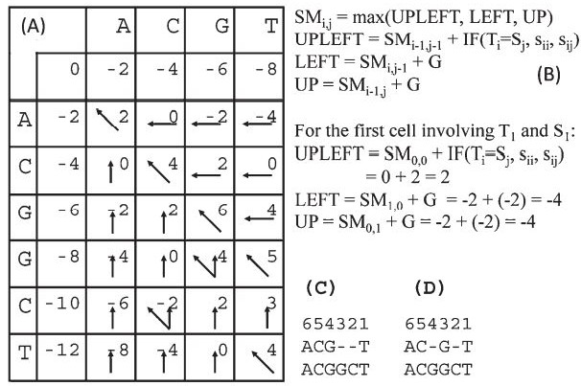
Needleman and Wunsch : Global Alignment
We need to fill in two matrices
The first is the scoring matrix (SM) to obtain the alignment score, with the dimensions (n+1, m+1).
A value in row i and column j in the scoring matrix (SM_{i,j}) is the alignment score between prefixes S_{j} and T_{i} .
The second is the backtrack matrix needed to obtain the actual alignment, with the dimensions (n,m).

Slide 78
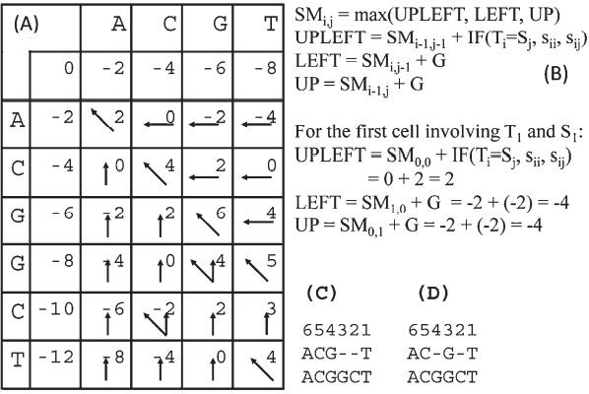
Needleman and Wunsch : Global Alignment
The two matrices are superimposed, with the scoring matrix being the numbers and the backtrack matrix being made of arrows.
The backtrack matrix is sometimes called the traceback matrix.
The first row (SM0,j) and the first column (SMi,0) of the scoring matrix is filled with i×G (where i = 0, 1, ..., n) and j×G (where j = 0, 1,
..., m), respectively.
They represent consecutive insertion of gaps.

Slide 79
Needleman and Wunsch : Global Alignment
For example, SM = −8 implies the
0,4
alignment of S against four consecutive gaps, so you get an alignment score of -8 (with gap penalty of −2).
Similarly, SM = −12 implies the alignment
6,0
of T with six consecutive gaps.

Slide 80
Needleman and Wunsch : Global Alignment
For each of the other SM values, we need to
i,j
compute three values designated as UPLEFT, LEFT, and UP
The first cell corresponds to T and S , both
1 1
being A, with its UPLEFT, LEFT, and UP values being 2, –4, and –4, respectively.
The maximum of these three values is UPLEFT
(=2), so SM_{1,1} = 2, and we put an upleft arrow in
the cell
If LEFT (or UP) happened to be the maximum of the three, we would have put the LEFT (or UP) value in the cell and add a left-pointing (or
up-pointing) arrow in the corresponding cell in the backtrack matrix.

Slide 81
Needleman and Wunsch : Global Alignment
The calculation of SM with the maximum
1,2
of the three values (UPLEFT, LEFT, UP) being 0.
So, we put 0 in the cell together with a left arrow (because LEFT is the maximum of the three).
We continue the computation from left to right and from top to bottom until we reach the bottom right cell to obtain SM_{6,4} = 4

Slide 82
Needleman and Wunsch : Global Alignment
This is the optimal alignment score for aligning S and T given the scoring scheme.
The aligned sequences are obtained directly from
the backtrack matrix without any reference to the scoring matrix.
We start from the bottom-right cell and follow the direction of the arrow in the cell.
The upleft arrow in the bottom-right cell means that
we should stack the two corresponding nucleotides
(T and T) in the row and column sequences
regardless of whether they are the same or different.
A left-pointing or up-pointing arrow in the cell
means a gap in the column sequence or row sequence, respectively.

Slide 83
Sequence Alignment
The concept of ‘local alignment’ was introduced by Smith & Waterman in 1981.
A local alignment of 2 sequences is an alignment between parts of the 2 sequences
Two proteins may one share one stretch of high sequence similarity, but be very dissimilar outside that region
A global (N-W) alignment of such sequences would have:
lots of matches in the region of high sequence similarity
lots of mismatches & gaps (insertions/deletions) outside the region of similarity
It makes sense to find the best local alignment instead

Slide 84
Smith and Waterman : Local Alignment
Local sequence alignment (Smith and Waterman, 1981) is similar to the global alignment, with only three major differences.
First, the first row and the first column of the scoring matrix is filled with zero instead of i×G.
Second, whenever the cell value becomes negative (i.e., the maximum of the three values is smaller than 0), the cell value is set to 0. Thus, when two sequences have a short but perfect local match, and little similarity elsewhere, the alignment score of the short but perfect match is not negatively affected by the low similarity elsewhere.
Third, because a local alignment can end anywhere in the matrix, we will not trace back from the cell in the bottom-right corner of the scoring matrix. Instead, we find the maximal score in the matrix and trace back from that point until we reach a cell with a value of 0, which indicates the start of the local alignment.

Slide 85
Sequence Alignment
There is no single “correct” alignment, only an alignment that is “optimal” according to some set of calculations.
This is partly due to:
limitations of the scoring systems used,
our limited understanding of life and evolution
Determining what alignment is best for a given set of sequences is really up to the judgment of the researcher.
Success of the alignment will depend on the similarity of the sequences.
If sequence variation is great it will be very difficult to find an optimal alignment.

Slide 86
Sequence Alignment : Heuristic Database Searching
There are two fundamental types of algorithms in bioinformatics.
One is the exhaustive type, which uses a rigorous algorithm to find the best or exact solution for a particular problem by examining all mathematical combinations. (Dynamic programming algorithm)
Another is the heuristic type, which is a computational strategy to find an empirical or near optimal solution.
Essentially, this type of algorithms take shortcuts by reducing the search space according to some criteria.
However, the shortcut strategy is not guaranteed to find the best or most accurate solution.
It is often used because of the need for obtaining results within a realistic time frame without significantly sacrificing the accuracy of the computational output.

Slide 87
Sequence Alignment : Heuristic Database Searching
A main application of pairwise alignment is retrieving biological sequences in databases based on similarity.
This process involves submission of a query sequence and performing a pairwise comparison of the query sequence with all individual sequences in a database.
Thus, database similarity searching is pairwise alignment on a large scale.

Slide 88
Sequence Alignment : Heuristic Database Searching
This type of searching is one of the most effective ways to assign putative functions to newly determined sequences.
However, the dynamic programming method is slow and impractical to use in most cases.
Special search methods are needed to speed up the computational process of sequence comparison.

Slide 89
Sequence Alignment : Heuristic Database Searching
The first criterion is sensitivity, which refers to the ability to find as many correct hits as possible.
It is measured by the extent of inclusion of correctly identified sequence members of the same family (True positive).
The second criterion is selectivity, also called specificity, which refers to the ability to exclude incorrect hits (False positive).
The third criterion is speed, which is the time it takes to get results from database searches.
Depending on the size of the database, speed sometimes can be a primary concern.

Slide 90
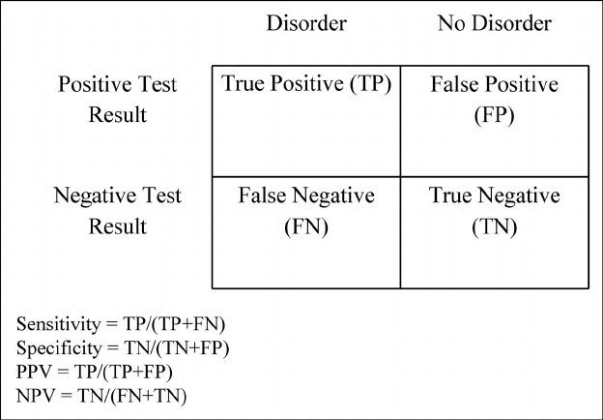
Sequence Alignment : Heuristic Database Searching
What generally happens is that an increase in sensitivity is associated with decrease in selectivity.
A very inclusive search tends to include many false positives.
Similarly, an improvement in speed often comes at the cost of lowered sensitivity and selectivity.
A compromise between the three criteria often has to be made.

Slide 91
Sequence Alignment : Heuristic Database Searching
Searching a large database using the dynamic programming methods, is too slow and impractical when computational resources are limited.
Querying a database of 300,000 sequences using a query sequence of 100 residues took 2–3 hours to complete with a regular computer system at the time.
To speed up the comparison, heuristic methods have to be used.
The heuristic algorithms perform faster searches because they examine only a fraction of the possible alignments examined in regular dynamic programming.
FASTA and BLAST

Slide 92
Sequence Alignment : Heuristic Database Searching
Both BLAST and FASTA use a heuristic word method for fast pairwise sequence alignment.
It works by finding short stretches of identical or nearly identical letters in two sequences.
These short strings of characters are called words, which are similar to the windows used in the dot matrix method.
The basic assumption is that two related sequences must have at least one word in common.
By first identifying word matches, a longer alignment can be obtained by extending similarity regions from the words.

Slide 93
Sequence Alignment : Heuristic Database Searching
BLAST(Basic Local Alignment Search Tool )
The BLAST program was developed by Stephen Altschul of NCBI in 1990
One of the most popular programs for sequence analysis.
The main idea of BLAST is that there are often High-scoring Segment Pairs (HSP) contained in a statistically significant alignment.
Available from www.ncbi.nlm.nih.gov/blast
BLAST requires a query sequence to search for, and a sequence to search against (also called the target sequence) or a sequence database containing multiple such sequences.
BLAST will find sub-sequences in the database which are similar to subsequences in the query.

Slide 94
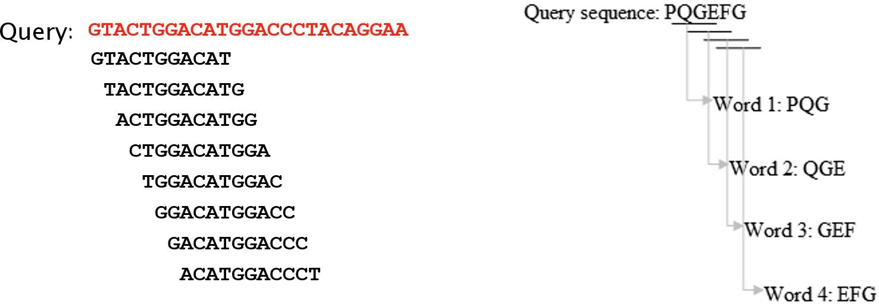
Sequence Alignment : Heuristic Database Searching
BLAST(Basic Local Alignment Search Tool )
First step, called as seeding, is to create a k-letter word list from the query sequence.
The list includes every possible word extracted from the query sequence.
k is usually 3 for protein sequences and 11 for DNA sequences.
This is the lookup table

Slide 95
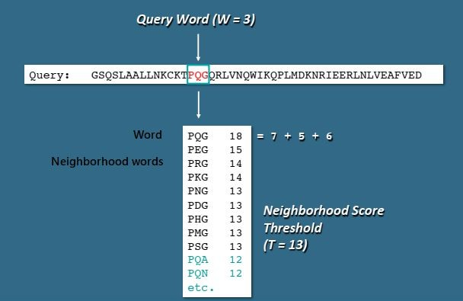
Sequence Alignment : Heuristic Database Searching
BLAST(Basic Local Alignment Search Tool )
The second step is to list all the possible matching words.
BLAST cares about the high-scoring words.
For a given word length w and a given score matrix:
Create a list of all words (w-mers) that can score >T when compared to w-mers from the query.

Slide 96
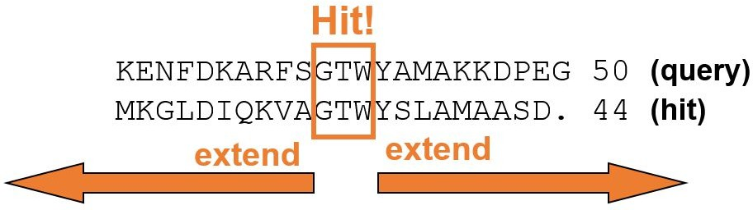
Sequence Alignment : Heuristic Database Searching
BLAST(Basic Local Alignment Search Tool )
The third step is to search a sequence database for the occurrence of these words. The matching of the words is scored by a given substitution matrix.
A word is considered a match if it is above a threshold.
The next step involves pairwise alignment by extending from the words in both directions while counting the alignment score using the same substitution matrix.

Slide 97
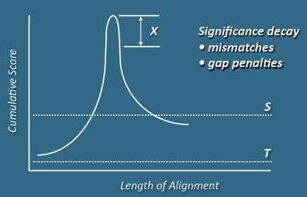
Sequence Alignment : Heuristic Database Searching
BLAST(Basic Local Alignment Search Tool )
The extension continues until the score of the alignment drops below a threshold due to mismatches (the drop threshold is twenty-two for proteins and twenty for DNA).
The resulting contiguous aligned segment pair without gaps is called high-scoring segment pair (HSP).
A recent improvement in the implementation of BLAST is the ability to provide gapped alignment.
In gapped BLAST, the highest scored segment is chosen to be extended in both directions using dynamic programming where gaps may be introduced.

Slide 98
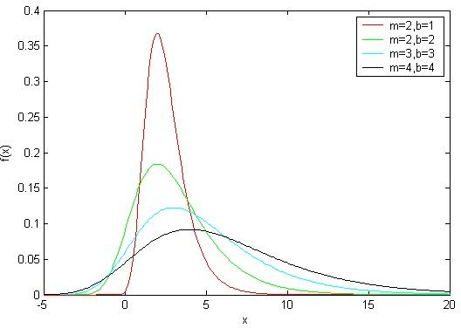
Sequence Alignment : Heuristic Database Searching
BLAST(Basic Local Alignment Search Tool )
We list the HSPs whose scores are greater than the empirically determined cutoff score S.
By examining the distribution of the alignment scores modeled by comparing random sequences, a cutoff score S can be determined such that its value is large enough to guarantee the significance of the remaining HSPs.
BLAST next assesses the statistical significance of each HSP score by exploiting the Gumbel extreme value distribution (EVD).

Slide 99
Sequence Alignment : Heuristic Database Searching
BLAST(Basic Local Alignment Search Tool )
Make two or more HSP regions into a longer alignment.
Sometimes, we find two or more HSP regions in one database sequence that can be made into a longer alignment.
This provides additional evidence of the relation between the query and database sequence.
Report every match whose expect score is lower than a threshold parameter E.

Slide 100
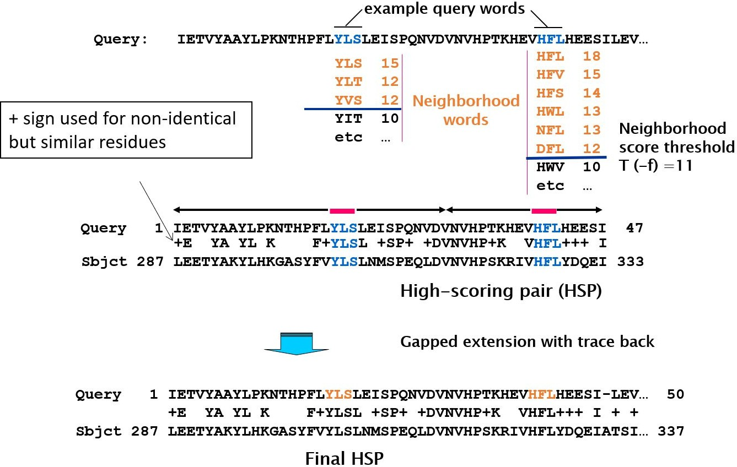
Sequence Alignment : Heuristic Database Searching
BLAST(Basic Local Alignment Search Tool )

Slide 101
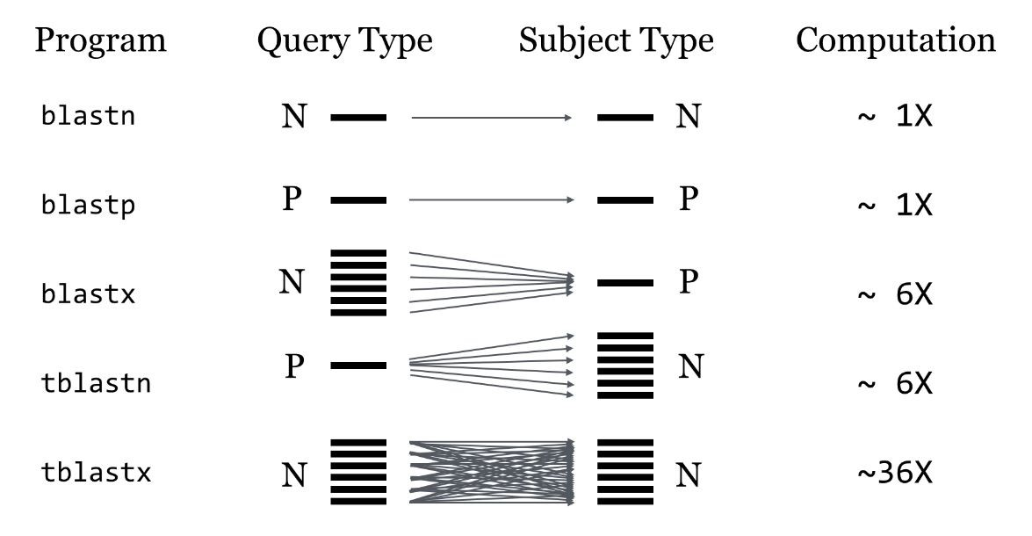
Sequence Alignment : Heuristic Database Searching
BLAST(Basic Local Alignment Search Tool )
Blastn: compares nucleotide query against nucleotide sequence database
Blastp: compares protein query against protein sequence database.
Blastx: compares six frame conceptual translation products of a nucleotide query sequence (both strands) against a protein sequence database.
tBlastn: compares protein query against the all six reading frames of a translated nucleotide sequence database.
tBlastx: compares nucleotide query against translated nucleotide sequence database.

Slide 102
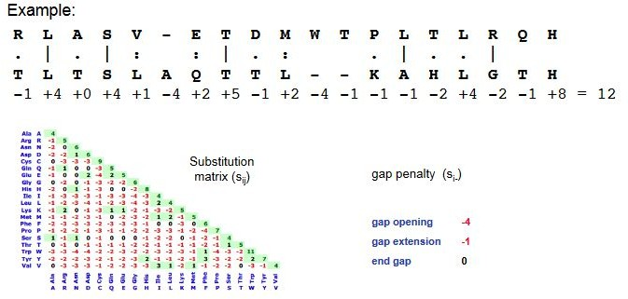
Sequence Alignment : Heuristic Database Searching
BLAST(Basic Local Alignment Search Tool )
Score: A number used to assess the biological relevance of a finding.
In the context of sequence alignments, a score is a numerical value that describes the overall quality of an alignment.
Higher numbers correspond to higher similarity.
The score scale depends on the scoring system used (substitution matrix, gap penalty).

Slide 103
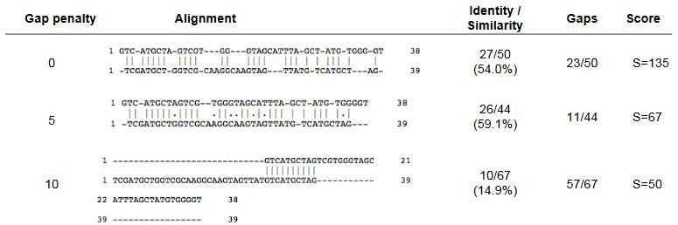
Sequence Alignment : Heuristic Database Searching
BLAST(Basic Local Alignment Search Tool )
Gap Penalty: If the gap penalty is too large, gaps are avoided and the sequences can not be properly aligned.
If the gap penalty is too low, gaps are inserted everywhere to prevent mismatches. This does not produce any informative alignment.
The "best" alignment is obtained for an intermediary gap penalty.

Slide 104
Sequence Alignment : Heuristic Database Searching
BLAST(Basic Local Alignment Search Tool )
Raw scores directly obtained from a matrix have no meaning if you do not specify the scoring scheme used.
Raw scores are normalized to get Bit scores by incorporating information about the scoring scheme used.
The bit-score S' is a normalized score expressed in bits that lets you estimate the magnitude of the search space you would have to look through before you would expect to find an score as good as or better than this one by chance.
Because bit scores are normalized with respect to the scoring system, Bit scores allow to compare results between different database searches, even using different scoring matrices.

Slide 105
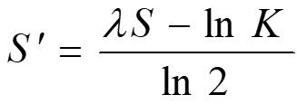

Sequence Alignment : Heuristic Database Searching
•

Slide 106
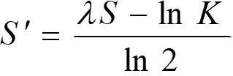
Sequence Alignment : Heuristic Database Searching
BLAST(Basic Local Alignment Search Tool )
Lambda (λ) is a scaling factor that describes the extent to which the raw score of an alignment is expected to vary by chance. It is estimated based on the frequency of matches and mismatches in the database sequences. The higher the λ value, the more significant the alignment score.
K is the value of the Karlin-Altschul parameter, which takes into account the length and composition of the query and database sequences. K is calculated using λ and the database size. The higher the K value, the more relaxed the statistical significance threshold for the alignment score.
The higher the bit score, the more highly significant the match is.
A Bit score refers to a particular alignment and is independent of the size of the database.
The bit score, S', is derived from the raw alignment score, S, taking the statistical properties of the scoring system into account.

Slide 107
Sequence Alignment : Heuristic Database Searching
BLAST(Basic Local Alignment Search Tool )
E.g.: If the bit-score is 30, one would have to score, on average, about 2³⁰ = 1 billion independent segment pairs to find this score by chance. Each additional bit doubles the size of the search space.
The bit-score is thus a rescaled version of the raw alignment score that is independent of the size of the search space.
The size of the search space is proportional to the product of the query sequence length (n) * the sum of the lengths of the sequences in the database (m): N = n*m. The size of the search space is then obtained by multiplying N by a coefficient K.

Slide 108
Sequence Alignment : Heuristic Database Searching
BLAST(Basic Local Alignment Search Tool )
E.g.: When searching protein databases with protein query, K is about 0.13. Thus, for a protein of length n= 235 aa which is searched against a database of size m = 12496420 aa, the size of the search space is equal to 0.13* 235*12496420 = about 0.38 billion. In this case, a bit score of 30 (which corresponds to a scale of 2³⁰ = 1 billion) may have occurred by chance alone.

Slide 109
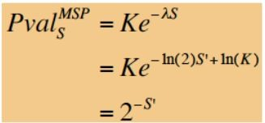
Sequence Alignment : Heuristic Database Searching
BLAST(Basic Local Alignment Search Tool )
In the context of sequence alignments, the P-value associated to a score S is the probability to obtain by chance a score x at least equal to S:
P-val (S) = P(x ≥ S)
This equation is derived from the Extreme Value Distribution (EVD) score distribution from all pair alignments

Slide 110
Sequence Alignment : Heuristic Database Searching
BLAST(Basic Local Alignment Search Tool )
Expectation value(E-value). The number of chance alignments with scores equivalent to or better than S that are expected to occur in a database search by chance.
The lower the E value, the more significant the score.
The E value decreases exponentially as the Score (S) that is assigned to a match between two sequences increases.
The E-value (expectation value) is a corrected bit-score adjusted to the sequence database size.
The E-value therefore depends on the size of the used sequence database. Since large databases increase the chance of false positive hits, the E-value corrects for the higher chance.

Slide 111
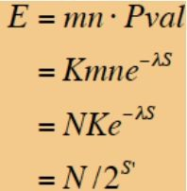
Sequence Alignment : Heuristic Database Searching
BLAST(Basic Local Alignment Search Tool )
m = query size
n= database size
K= minor constant
λ= constant to adjust for scoring matrix
S= score of High-scoring segment pair (HSP)

Slide 112
Sequence Alignment : Heuristic Database Searching
BLAST(Basic Local Alignment Search Tool )
Comparing a protein sequence of length 250 residues to a database of length one billion residues, how many local alignments with normalized score ≥ 35 bits can one expect to find by chance?
The search space size is approximately 2⁸ × 2³⁰ = 2³⁸, so E ≈ 2³⁸/2³⁵ = 2³ = 8.
The number of alignments with score ≥ 35 bits one can expect to find by chance is 8.
The number of alignments with score ≥ 45 bits one can expect to find by chance is 0.008.

Slide 113

Sequence Alignment : Heuristic Database Searching
BLAST(Basic Local Alignment Search Tool )
Karlin-Altschul equation
The value of E decreases exponentially with increasing S (higher S values correspond to better alignments). Very high scores correspond to very low E values.
The E value for aligning a pair of random sequences must be penalized otherwise, long random alignments would acquire great scores
Parameter K describes the search space (database).
For E=1, one match with a similar score is expected to occur by chance. For a very much larger or smaller database, you would expect E to vary accordingly.

Slide 114
Sequence Alignment : Heuristic Database Searching
BLAST(Basic Local Alignment Search Tool )
E-value 1e-50
small E-value: low number of hits, but of high quality
Blast hits with an E-value smaller than 1e-50 includes database matches of very high quality.
E-value 0.01
Blast hits with E-value smaller than 0.01 can still be considered as good hit for homology matches.
E-value 10
large E-value: many hits, partly of low quality
E-value smaller than 10 will include hits that cannot be considered as significant, but may give an idea of potential relations.

Slide 115
Sequence Alignment : Heuristic Database Searching
BLAST(Basic Local Alignment Search Tool )
P- Value (Probability value): Probability that an event occurs by chance
It is the probability of achieving an equal or higher score at random for an observed HSP (a high scoring segment pair )
Can we transfer P into E? ? P = 1-e^{-E}
A P value of 0.03 means that, there is a 3% chance of obtaining an equal or higher score at random for a particular HSP
When E < 0.01, P-values and E-values are nearly identical
P values range from 0 to 1
The BLAST programs report E-value rather than P-values because it is easier to understand the difference between, for example, E- value of 5 and 10 than P-values of 0.993 and 0.99995.

Slide 116
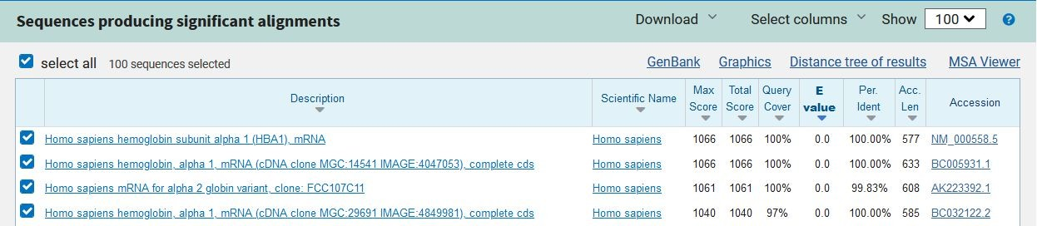
Sequence Alignment : Heuristic Database Searching
BLAST(Basic Local Alignment Search Tool )

Slide 117
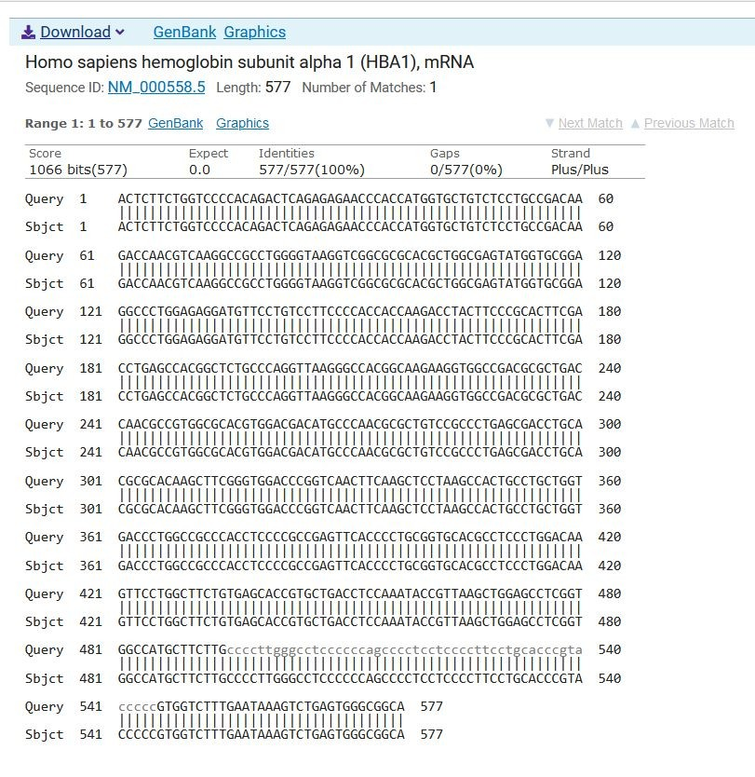
Sequence Alignment : Heuristic Database Searching
BLAST(Basic Local Alignment Search Tool )

Slide 118
Sequence Alignment : Heuristic Database Searching
BLAST(Basic Local Alignment Search Tool )
Low-complexity regions (LCR)
Regions that contain highly repetitive residues
Short segments of repeats
Segments that are overrepresented by a small number of residues
Can lead to false database matches and result in high sequence alignment
Hence it can cause ambiguity in real similarities
Low-complexity sequence can often be recognized by visual inspection.
For example, the protein sequence PPCDPPPPPKDKKKKDDGPP has low complexity and so does the nucleotide sequence AAATAAAAAAAATAAAAAAT.
Filters are used to remove low-complexity query sequence because it can cause artifactual hits.

Slide 119
Sequence Alignment : Heuristic Database Searching
BLAST(Basic Local Alignment Search Tool )
Masking is a procedure that identifies low-complexity sequence.
Masking can eliminate statistically significant but biologically uninteresting reports from the blast output, leaving the more biologically interesting regions of the query sequence available for specific matching against database sequences.
2 types of masking
Hard masking
Replaces LCR sequences with N (nucleotides) and X (amino acids)
Soft masking
Converts sequences into lower cases
Lower cases are ignored during word construction but used in word extension and optimization

Slide 120
Sequence Alignment : Heuristic Database Searching
FASTA
Program developed by Pearson & Lipman in 1988
FASTA is the first widely used program for sequence database similarity search
It is found to be slower than BLAST but more accurate
It uses “Hashing” strategy to find matches for short stretch of identical residues with length k (window size)
The string of residues are known as k-tuples
Hashing: FastA locates regions of the query sequence and matching regions in the database sequences that have high densities of exact word matches (without gaps). The length of the matched word is called the ktup parameter.

Slide 121
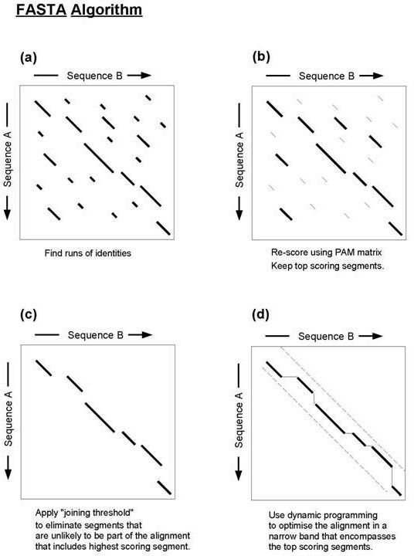
Sequence Alignment : Heuristic Database Searching
FASTA
Similar to dot matrix (construction of lookout table) with a window size of k

Slide 122
Sequence Alignment : Heuristic Database Searching
FASTA
Scoring: The ten highest scoring regions are rescored using a scoring matrix. The score for such a pair of regions is saved as the init1 score.
Introduction of Gaps: FastA determines if any of the initial regions from different diagonals may be joined together to form an approximate alignment with gaps. Only non-overlapping regions may be joined. The score for the joined regions is the sum of the scores of the initial regions minus a joining penalty for each gap. The score of the highest scoring region, at the end of this step, is saved as the initn score.
Diagonals are scored using scoring matrix PAM or BLOSOM
Non overlapping HSPs along the diagonals are selected and connected by allowing gaps
The gapped alignment is further refined using Smith-Waterman algorithm

Slide 123
Sequence Alignment : Heuristic Database Searching
FASTA
Random Sequence Simulation: In order to evaluate the significance of such alignment FastA empirically estimates the score distribution from the alignment of many random pairs of sequences.
More precisely, the characters of the query sequences are reshuffled (to maintain bias due to length and character composition) and searched against a random subset of the database.
This empirical distribution is extrapolated, assuming it is an extreme value distribution, and each alignment to the real query is assigned a Z-score and an E-score.
FASTA gives only one final alignment.

Slide 124
Sequence Alignment : Heuristic Database Searching
FASTA vs BLAST
Seeding step
BLAST uses substitution matrix for finding words.
FASTA uses hashing table for finding identical matches.
Sensitivity
FASTA is comparatively slower than BLAST however, FASTA scans smaller window sizes thus increasing sensitivity.
Selectivity
BLAST uses masking procedures for LCRs thus increasing selectivity (Exclusion of false positives).
Output
BLAST sometimes gives multiple best-scoring alignments but FASTA gives only one final alignments.

Slide 125
Thank You

